Slide 1
Supervised Learning (or “Helping expedite the impending takeover by our robot overlords”)
Daniel V Samarov, PhD
National Institute of Standards and Technology
Information Technology Laboratory
Statistical Engineering Division

Slide 2
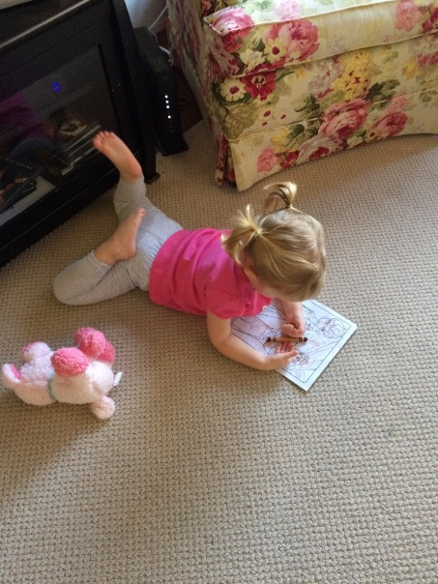
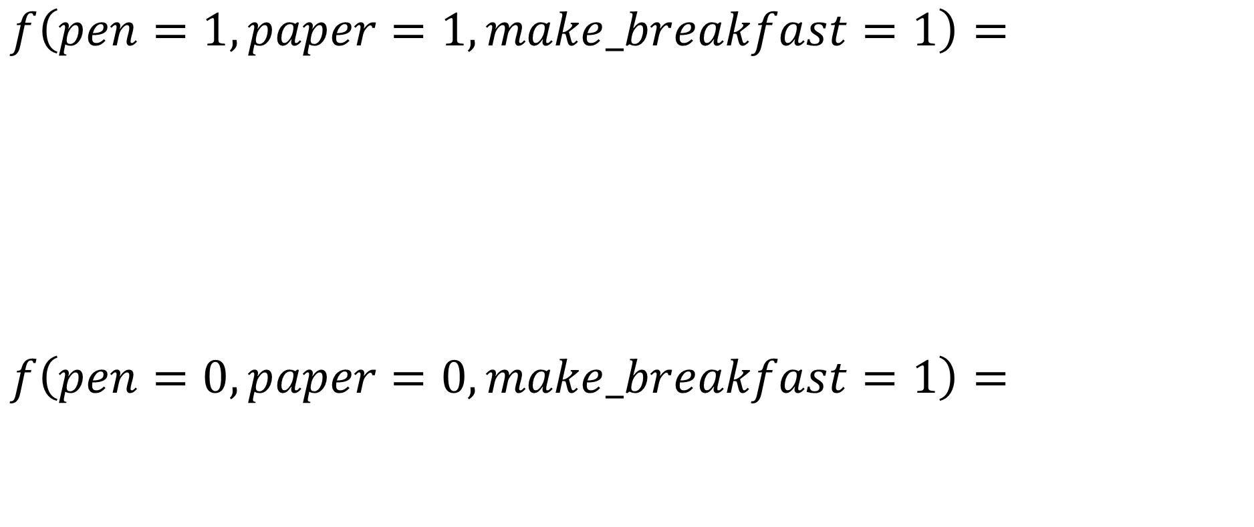

What is supervised learning aka can I can predict the probability that my daughter will make a mess?

Slide 3
What is supervised learning aka can I can predict the probability that my daughter will make a mess?
Mess
No Mess
1
1
Frequency
pen
paper
mb
pen
paper
mb
0
0

Slide 4

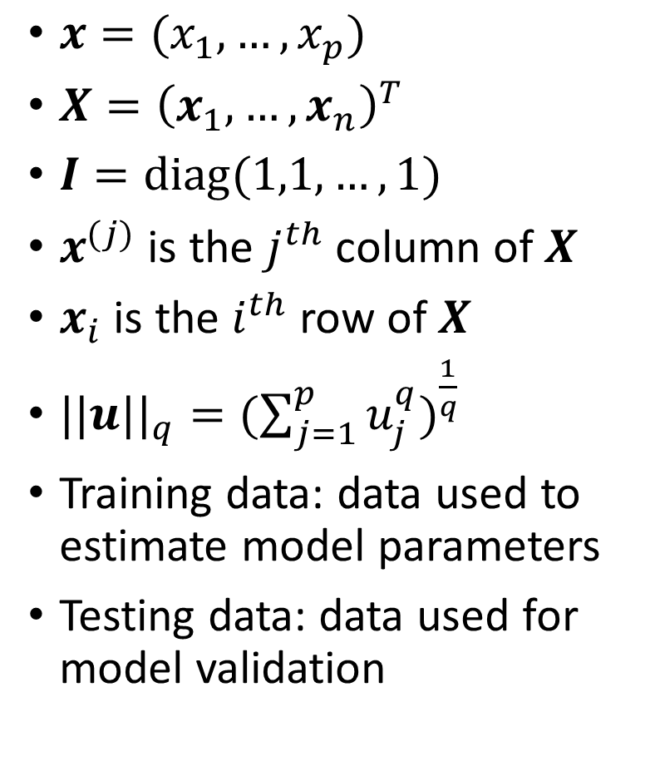
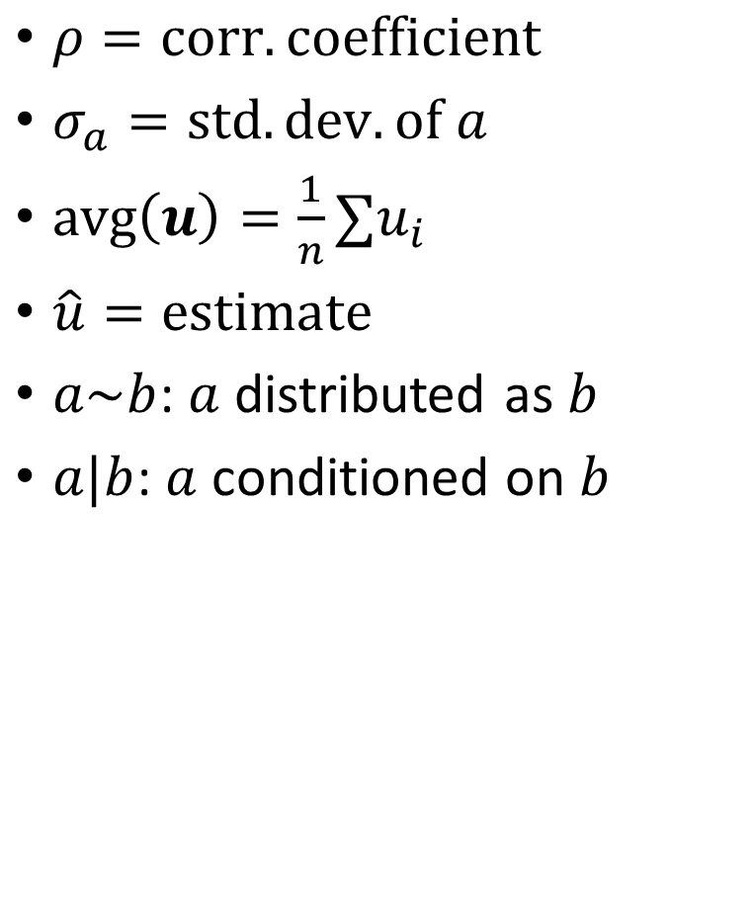
Notation & Terminology

Slide 5
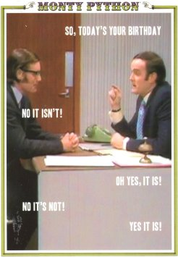
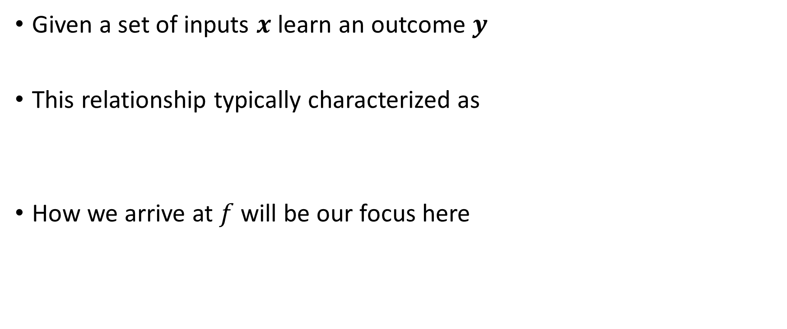
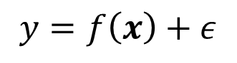
Where to start?

Slide 6
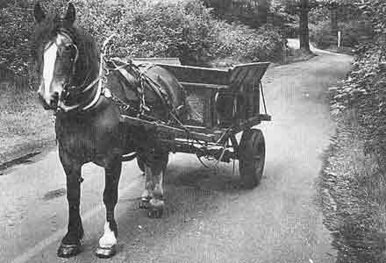
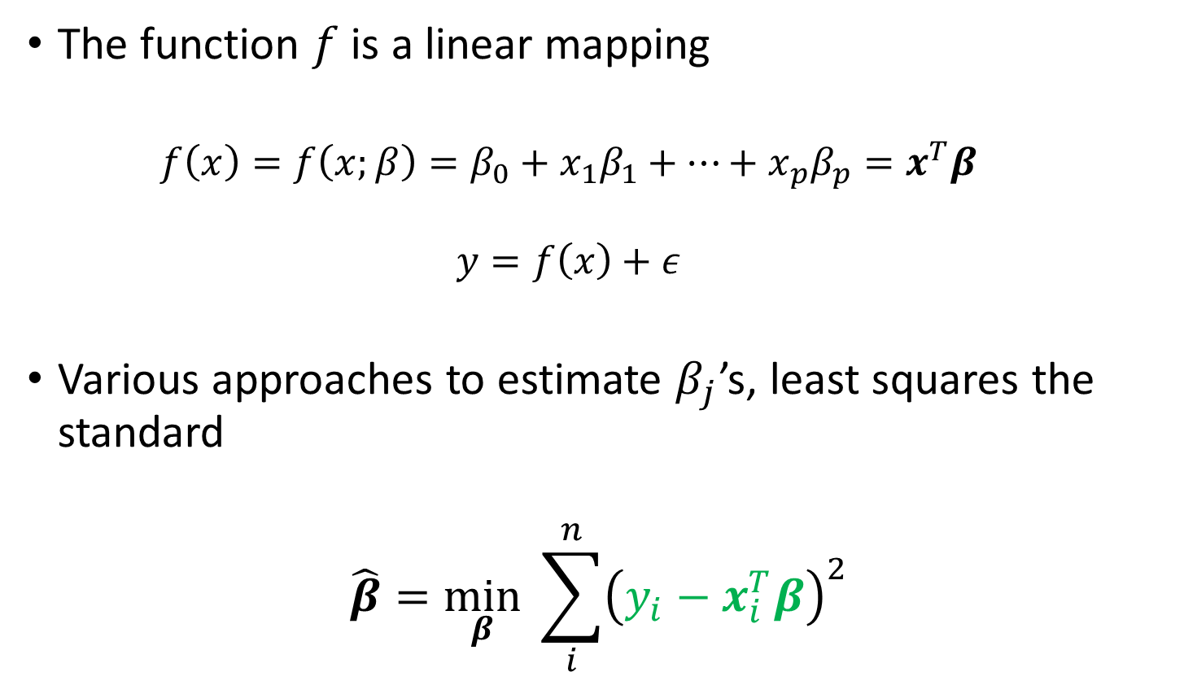
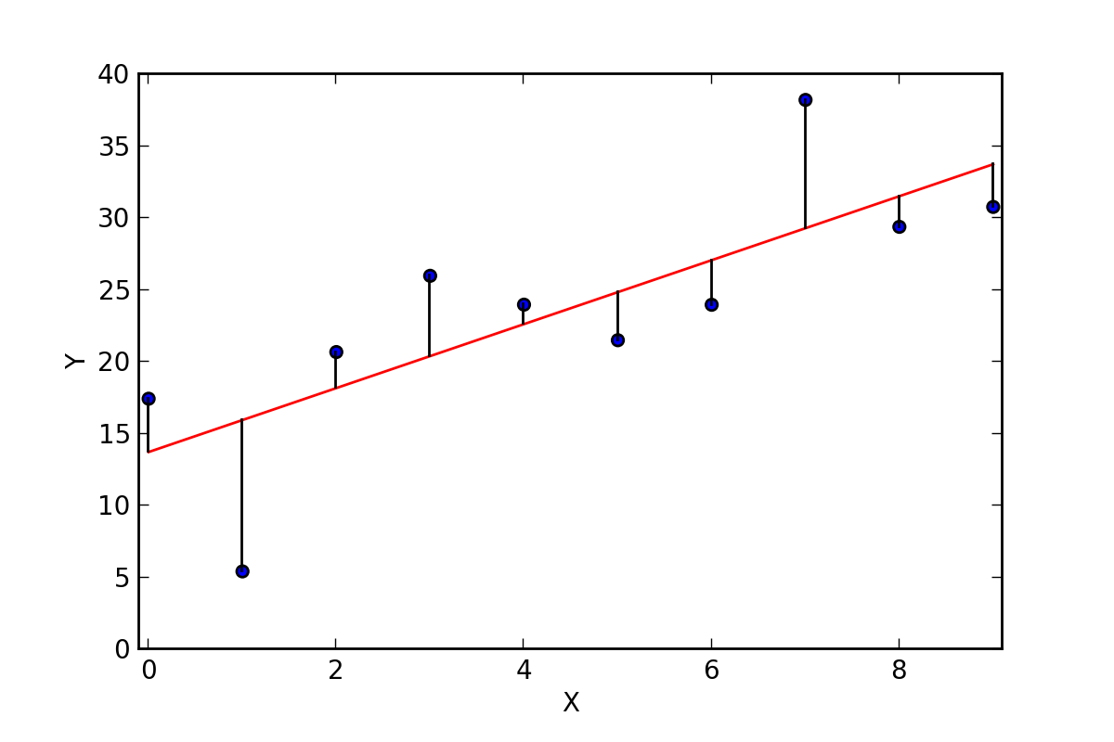
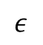
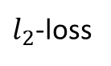
The old workhorse – Linear Regression (LinReg)

Slide 7
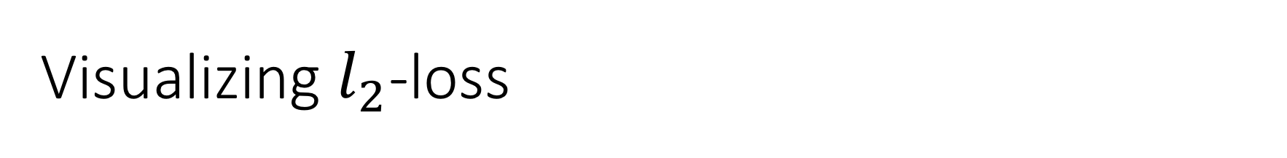
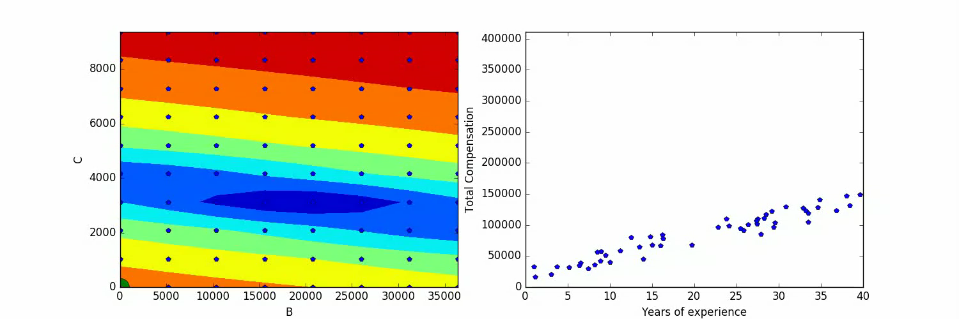


y
x

Slide 8
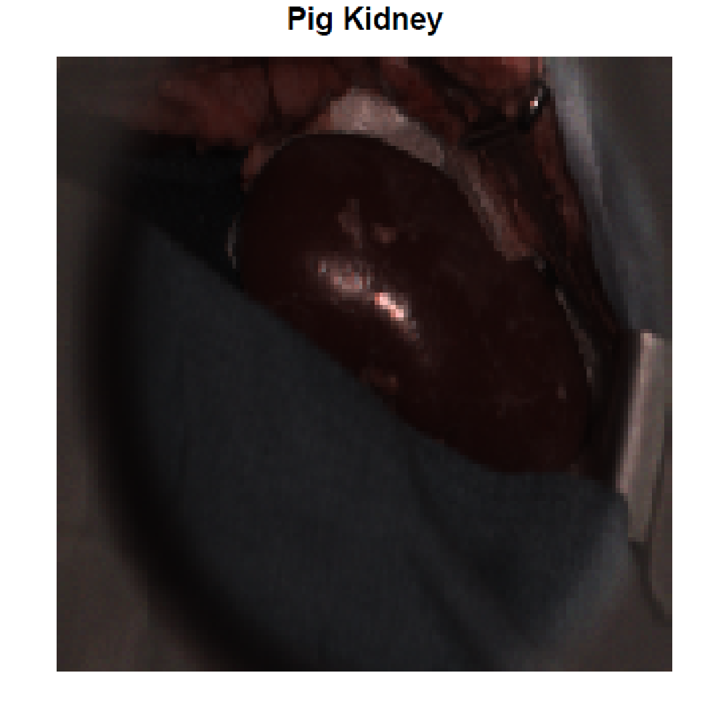
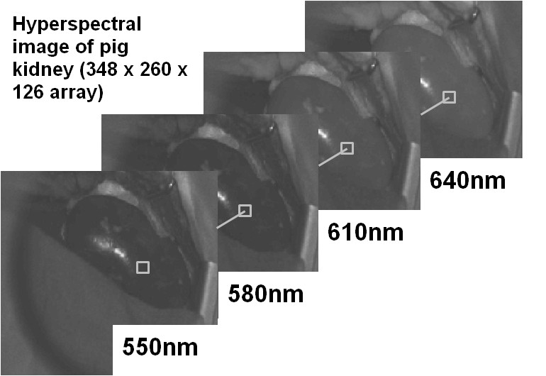
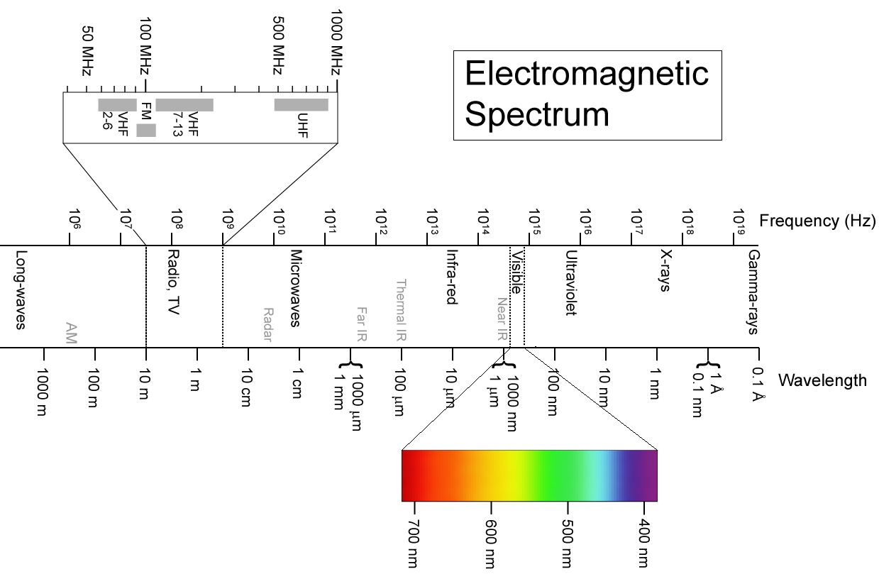
Example: Hyperspectral Imaging
Dense sampling of wavelengths along ES
Many molecules exhibit unique spectra
Can be leveraged in imaging applications
1
Intensity
0
550nm
640nm
Data courtesy of K. Zuzak et al.
Wavelength

Slide 9
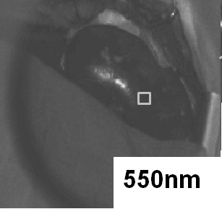
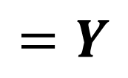
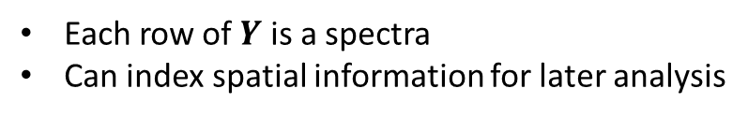
Initial Data Structuring
580nm
640nm
550nm
…
(N x L)
K
M
N = K x M
Raw Data
Expand each wave length
columnwise
Combine to form
Data matrix

Slide 10

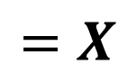
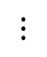
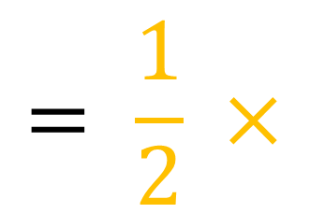
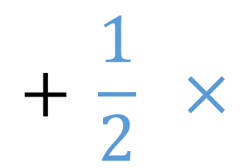

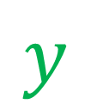
We need a few assumptions
Small # spectra compose image (endmembers)
Kidney
Fat
580nm
640nm
550nm
…
N = K x M

Slide 11
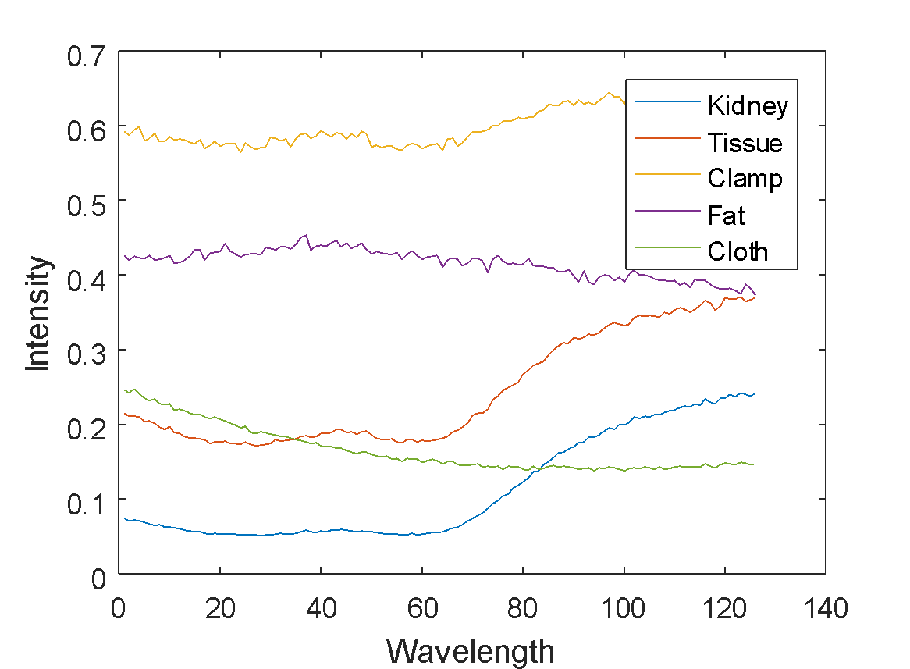
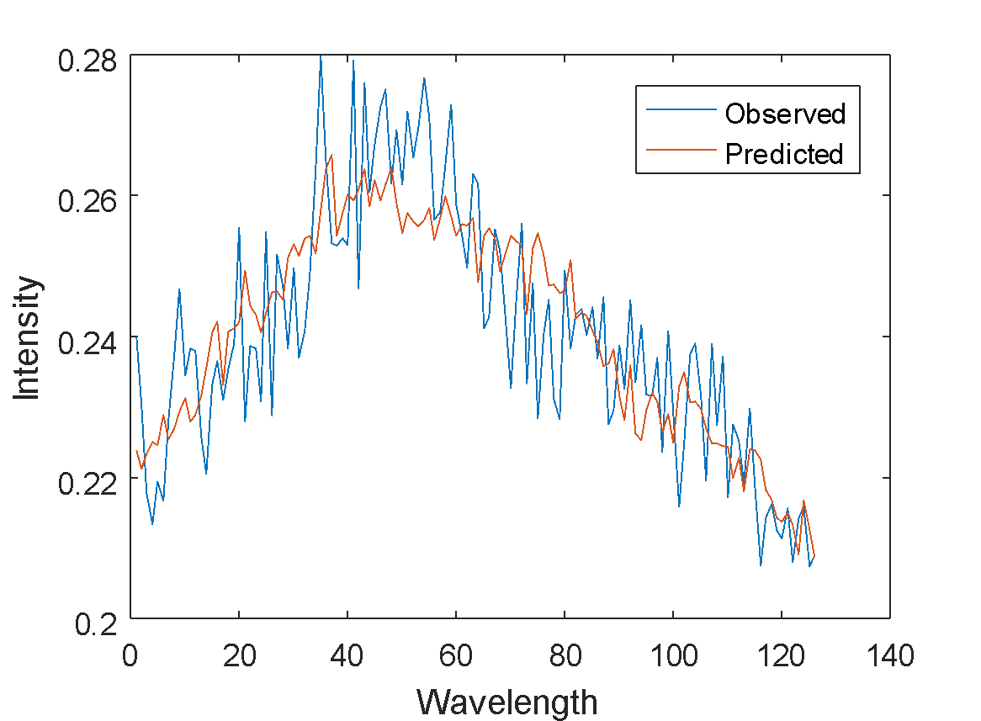
Results looking at a single spectra
Endmember | Coefficient estimate
Kidney | 0.0094
Tissue | -0.1643
Clamp | 0.1429
Fat | 0.6017
Cloth | -0.3425

Slide 12
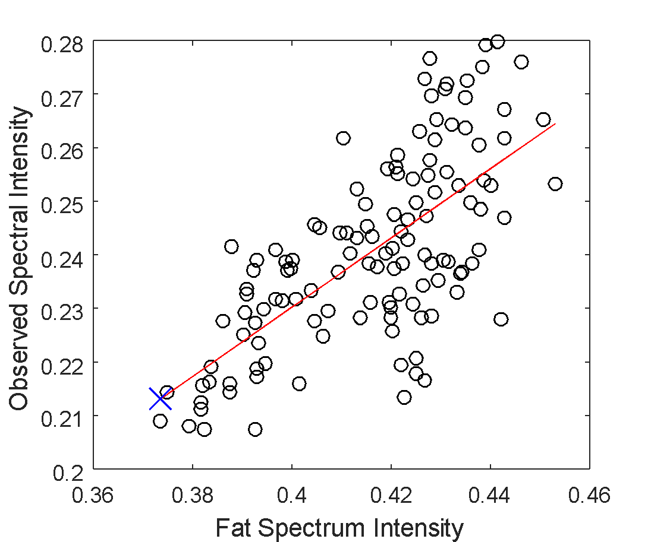
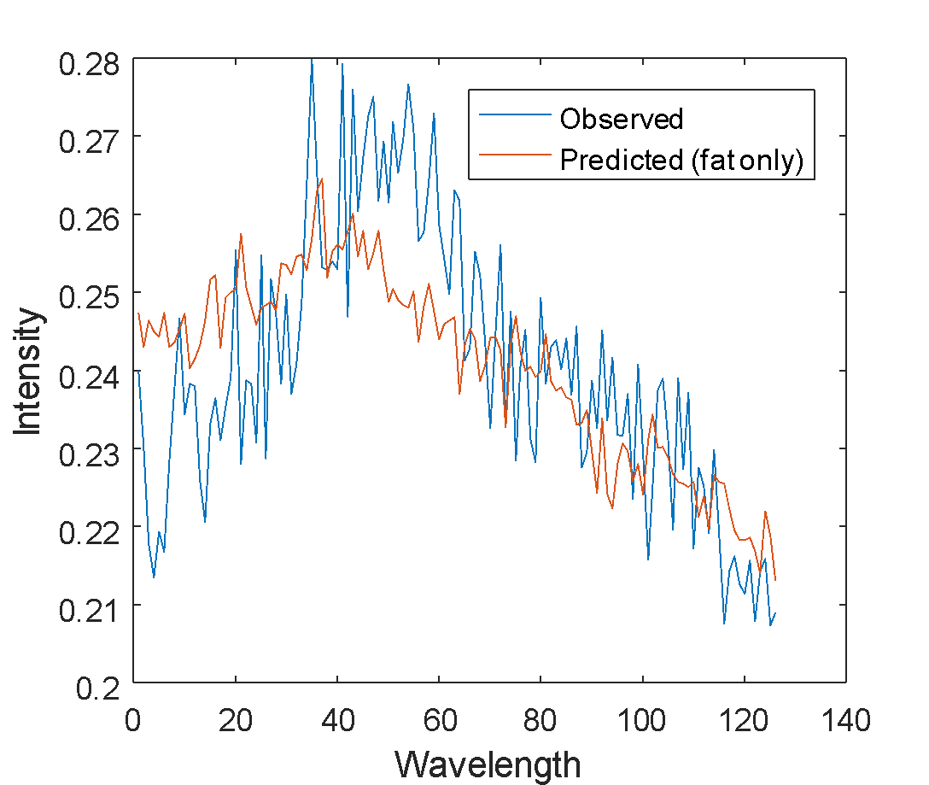
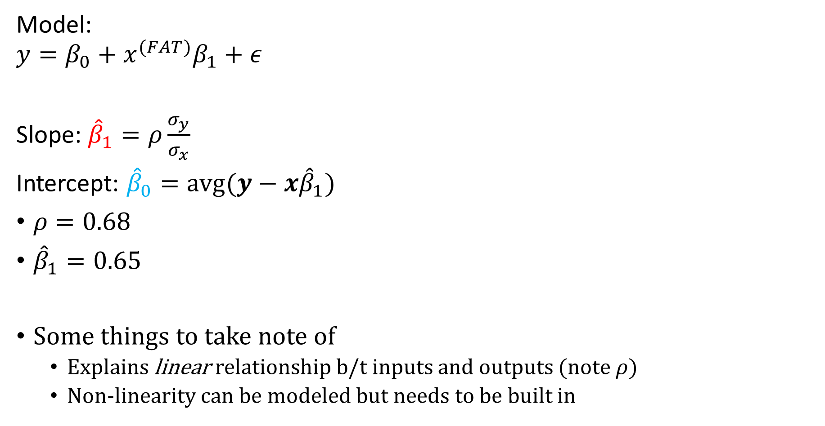
Univariate case (looking just at fat):

Slide 13

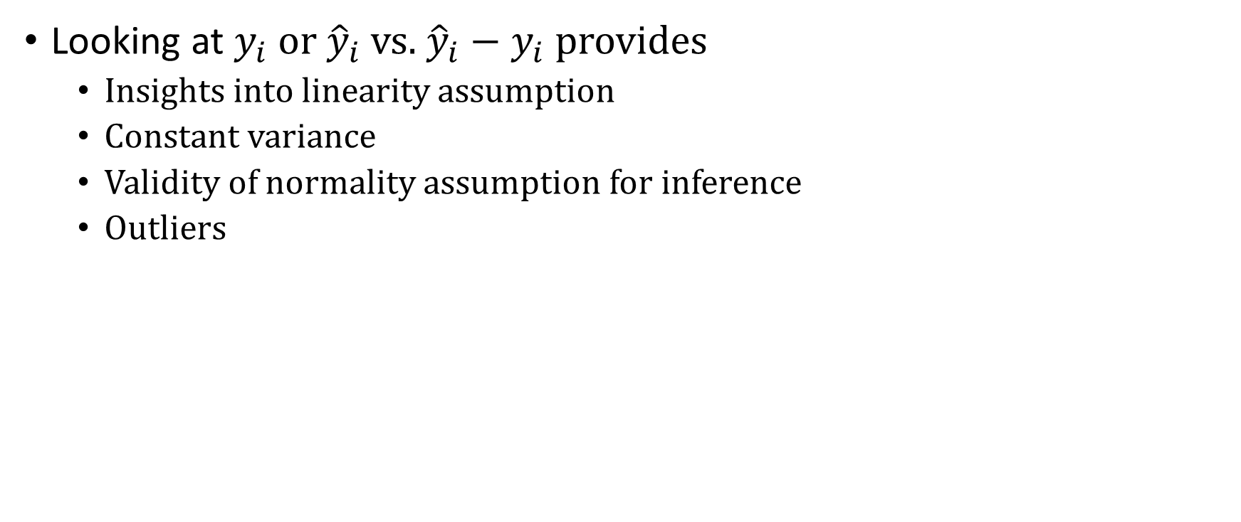
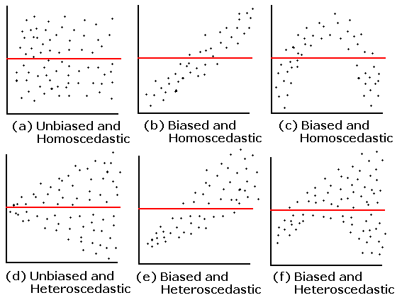
Always look at the residuals!!!

Slide 14
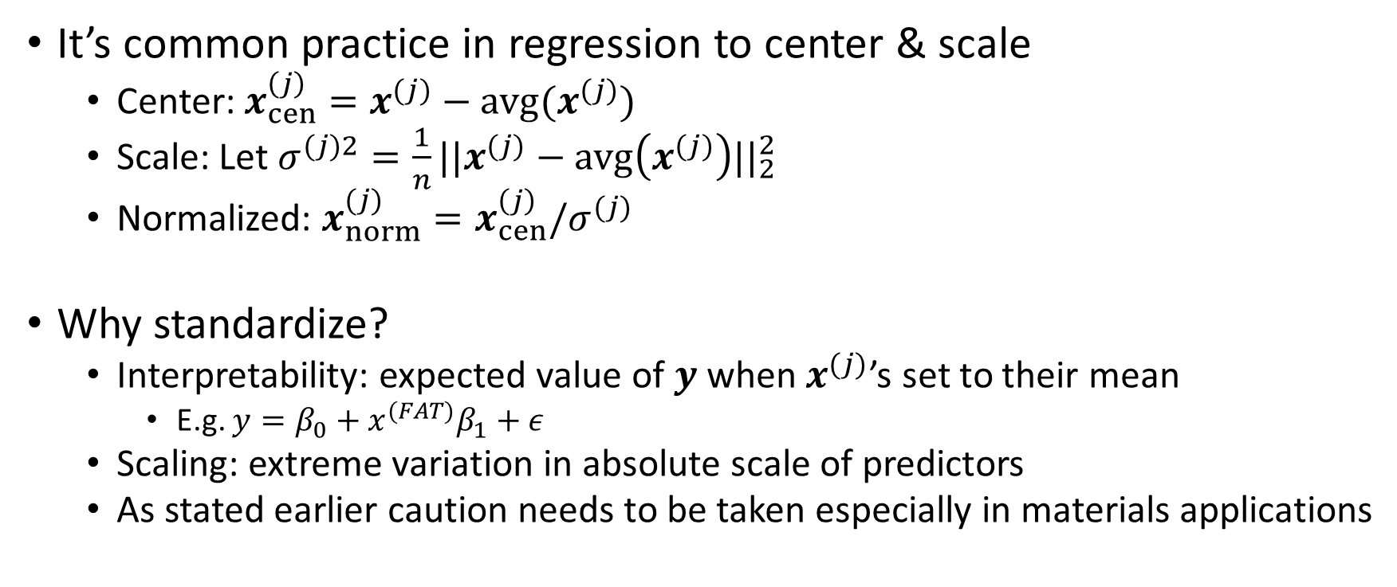
A note on centering & scaling

Slide 15
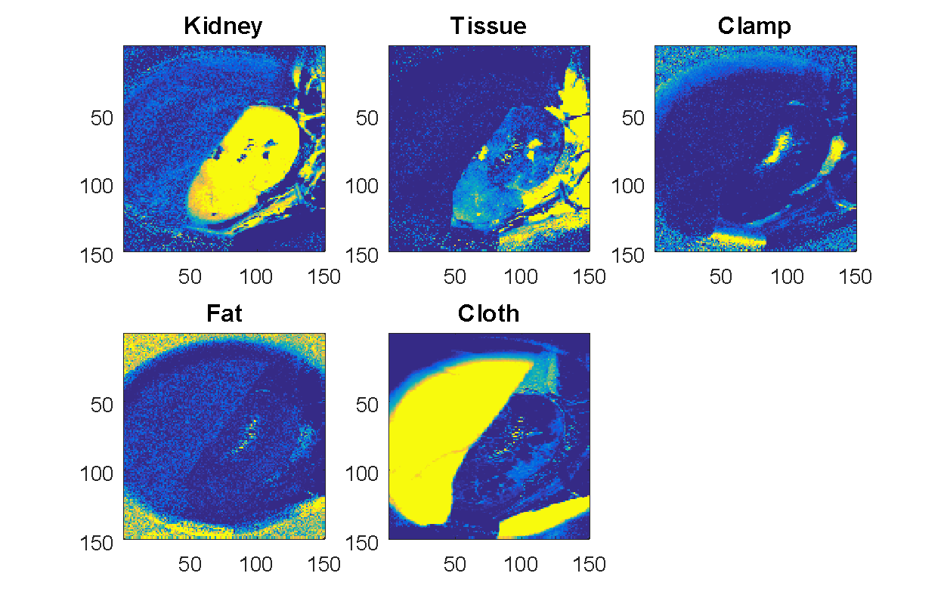
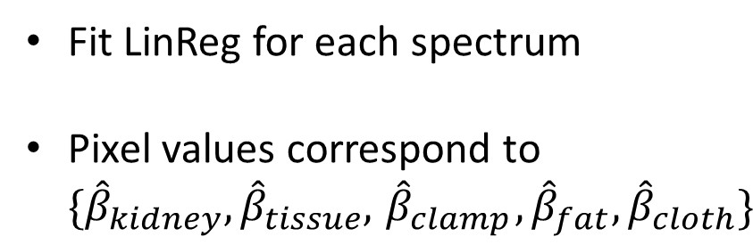
How does this map to the whole image?
580nm
640nm
550nm
…
N = K x M

Slide 16
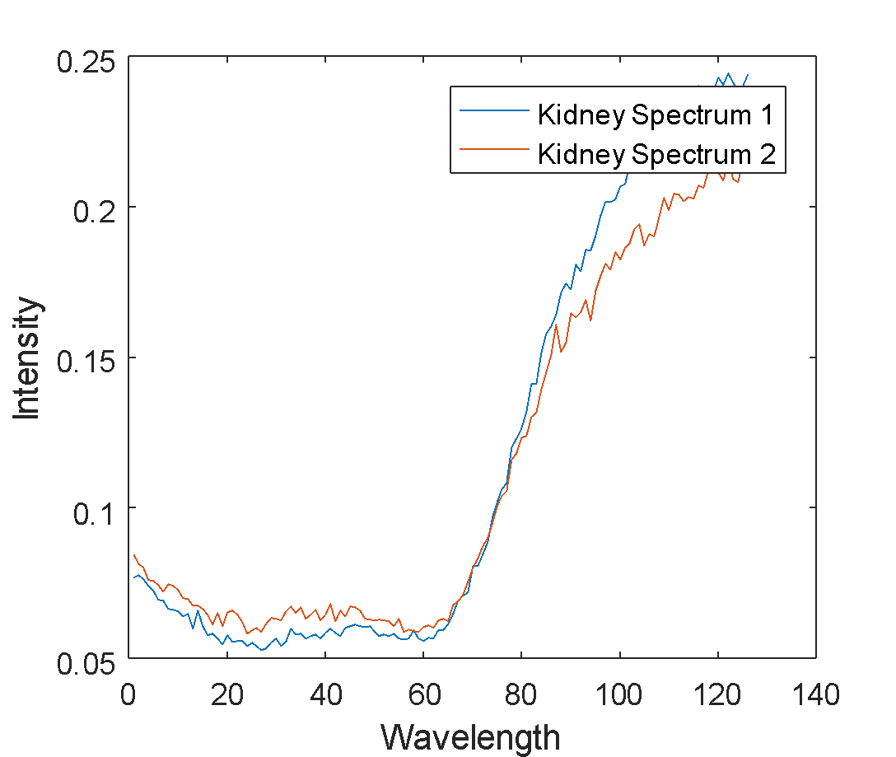
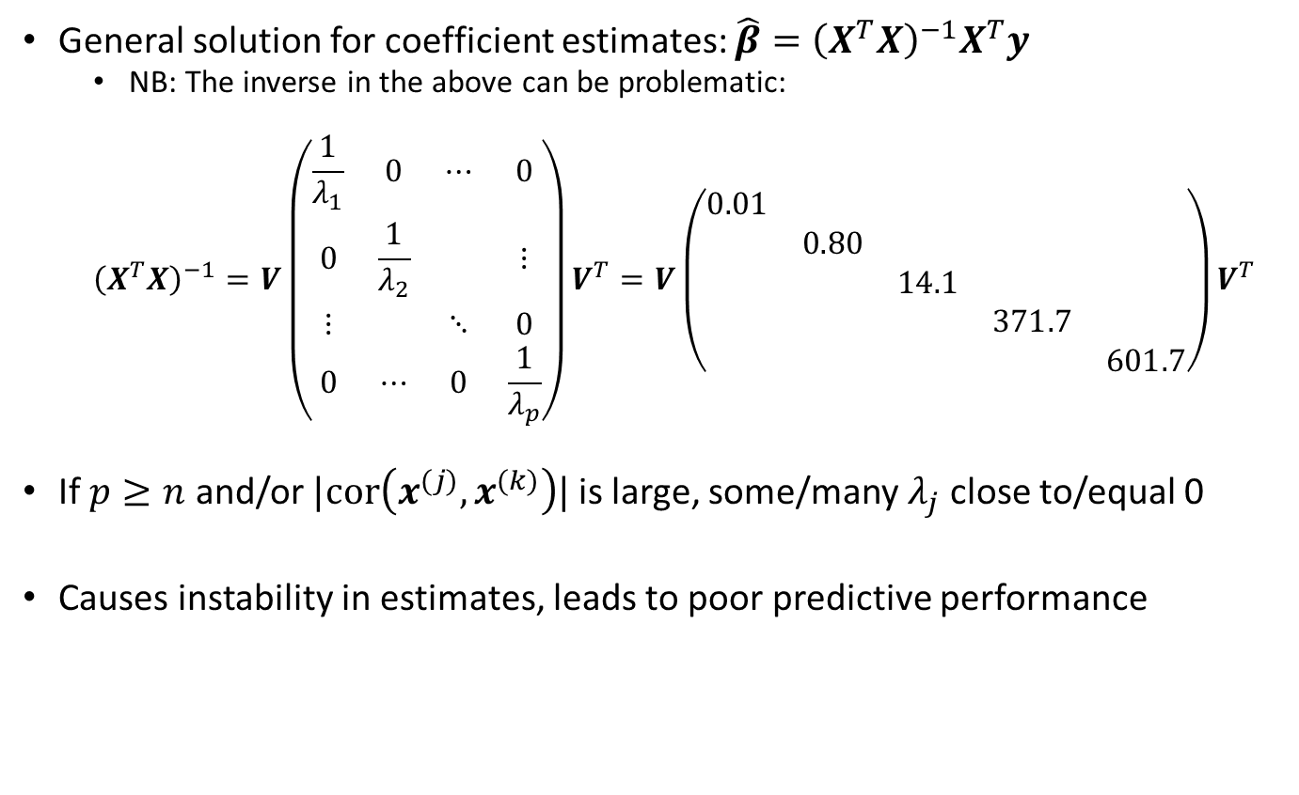
LinReg Challenges: Collinearity & High Dimensionality
Coefficient Estimates
 | Spectra 1 | Spectra 2
Kidney | 0.95 | 0.68
Tissue | 0.03 | 0.19
Clamp | 0.03 | -0.08
Fat | -0.05 | 0.07
Cloth | -0.002 | 0.03

Slide 17
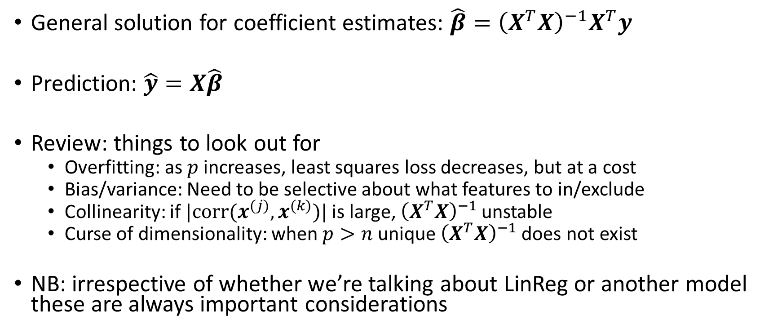
LinReg: Summary

Slide 18
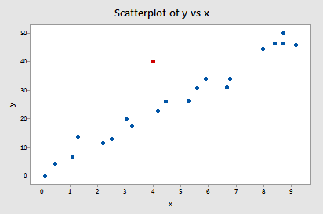
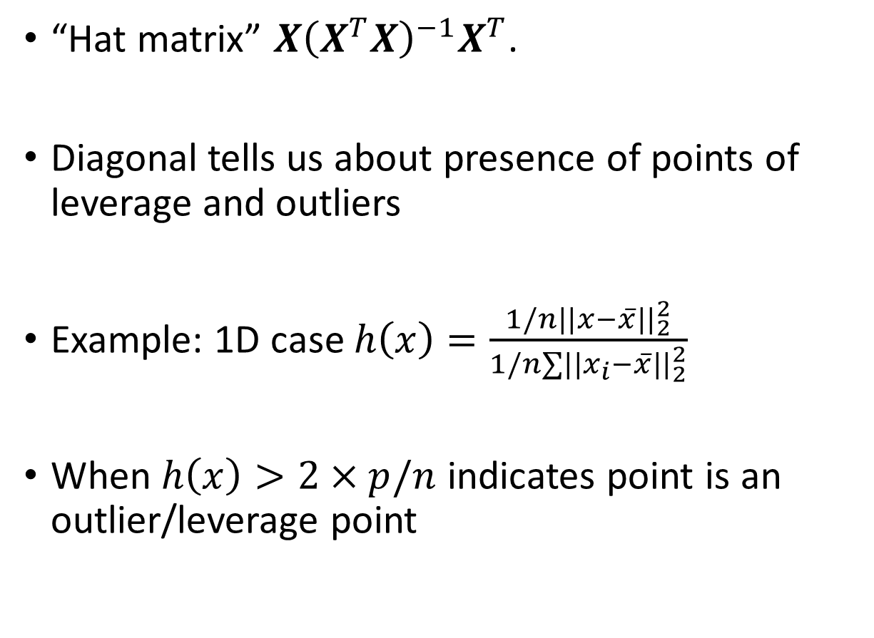
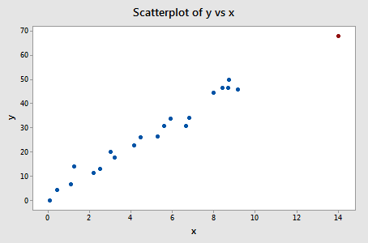
Hat Matrix and Outliers
Outlier
Leverage

Slide 19
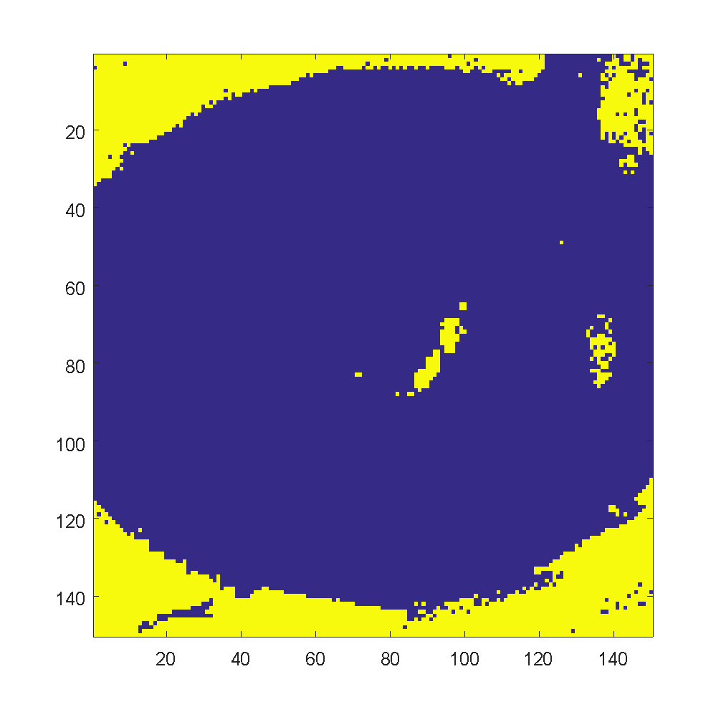
Hat Matrix and Outliers
Yellow regions are outliers

Slide 20
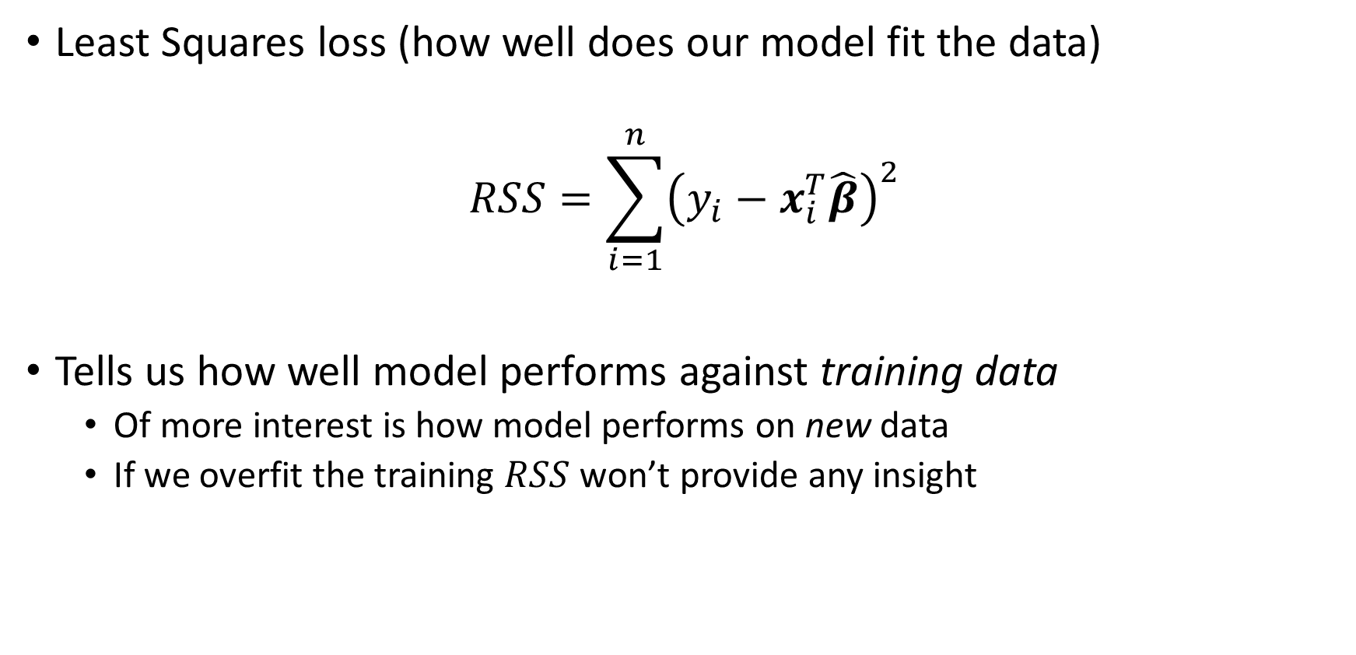
Model evaluation

Slide 21
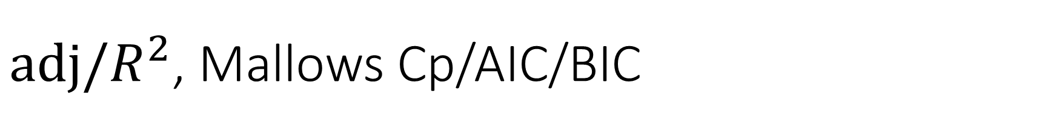
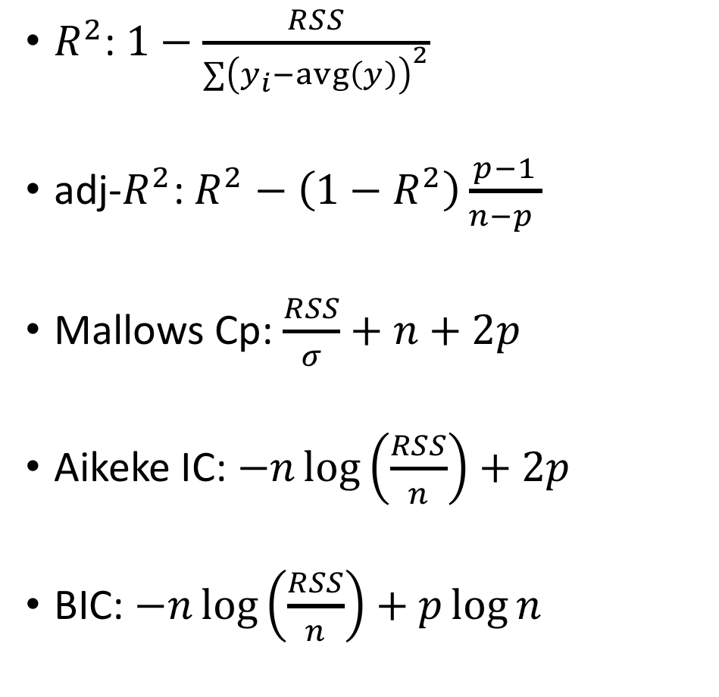
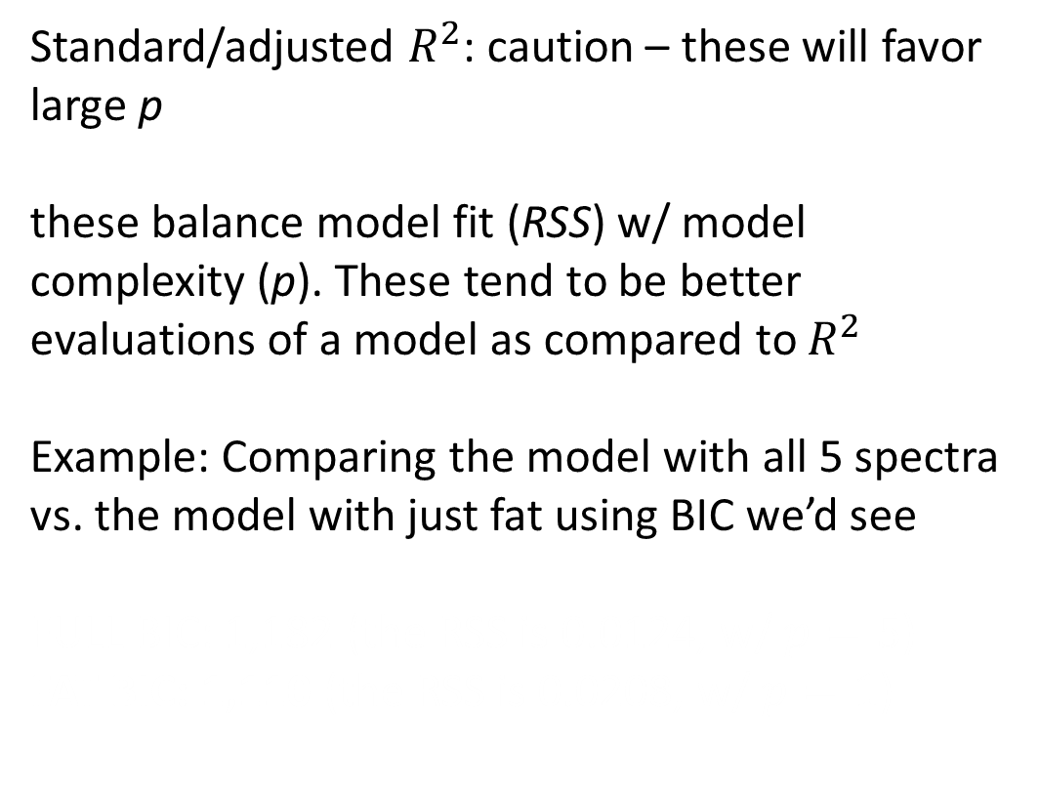

Slide 22
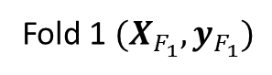
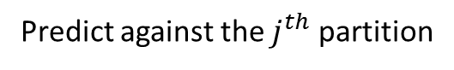
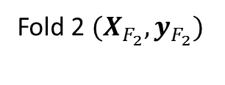
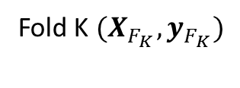
Cross Validation
Question: how will a model perform on new data?
Cross Validation should essentially be performed in any type of analysis
K fold Cross-validation
Training data
Build on K-1 partitions

Slide 23

Cross Validation

Slide 24
Coming back to data processing
It’s important to understand the end-to-end pipeline in our analysis
CV provides insight not just on the model, but the processing steps
Iterating through and exploring possibilities critical to analysis
Things get “interesting” when we start to hit computational limitations
For example, what would happen if we performed some pre-processing on our spectra prior to estimating abundances?

Slide 25



Bayesianism: lost cell phone
Frequentist: where did I leave my cell phone?
Bayesian: based on where I think I last left my phone where is it

Slide 26



Bayesian view full disclosure: I am not a Bayesian (or at least not intentionally)
Bayesians also think they’re really funny…

Slide 27


LinReg from a Bayesian perspective
Least squares!

Slide 28


How is this helpful
Since all models are wrong the scientist cannot obtain a "correct" one by excessive elaboration. On the contrary following William of Occam he should seek an economical description of natural phenomena. Just as the ability to devise simple but evocative models is the signature of the great scientist so overelaboration and overparameterization is often the mark of mediocrity. – George Box

Slide 29


Regularization: Ridge Regression

Slide 30

Regularization: Ridge Regression
 | Spectra 1 | Spectra 2
Kidney | 0.8 | 0.6
Tissue | 0.17 | 0.25
Clamp | 0.03 | -0.04
Fat | -0.08 | 0.01
Cloth | -0.002 | 0.03
Coefficient Estimates

Slide 31


How does this impact coefficient estimates?

Slide 32

Mapped to the HSI image
Standard Regression
Ridge Regression

Slide 33


What does Bayes think of this?

Slide 34


Sparsity constraints – Feature Selection

Slide 35

Coming back HSI
Standard Regression
LASSO Regression

Slide 36


LASSO Solution path

Slide 37

Elastic Net

Slide 38

Elastic Net Solution Path

Slide 39

Aside: Connection to PCA (and why that’s interesting)
This is just ridge regression!

Slide 40


Sparse PCA

Slide 41



Capturing non-linearity Basis Functions

Slide 42


Capturing non-linearity Relationship to Neural Networks (Part I)

Slide 43



Artificial Neural Networks (Regression)
sigmoid
(Image from Eric J. Ma)

Slide 44

Other Smoothers
Smoothing splines, Local polynomial regression, Kernel Smoothers
These can be extremely useful as processing signal process steps
Bandwidth region
Intensity
Wavelength

Slide 45
Other Smoothers
Caution does need to be taken in selection of smoothing parameters
Can easily result in the introduction of noise
Bandwidth region
Intensity
Wavelength

Slide 46

Continuous outcomes to discrete classes
1
These points will be misclassified, despite being perfectly separable
0.5
0

Slide 47

Classification (2 class)
Class “labels”
What is an “optimal” separating boundary
Things to consider:
Within & between class distribution
Can points be exactly partitioned
How can we handle “class imbalance”
To what degree will outliers effect boundary

Slide 48
K-nearest neighbor
One of the simplest and yet most efficient methods for classification
Algorithm:
Find a candidate points k nearest neighbors. “Near” is computed based on distance, Euclidean most common.
Take a “majority” vote to identify which class the point belongs to
In example above the orange point would receive 4 red votes and 1 blue.

Slide 49
Decision Trees
Simple and powerful method for both classification and regression

Slide 50
Decision Trees
Simple and powerful method for both classification and regression

Slide 51
Decision Trees
Simple and powerful method for both classification and regression

Slide 52
Decision Trees
Simple and powerful method for both classification and regression

Slide 53


Slide 54
Decision Trees
Variation for regression: use the mean within a split
Conditions for split
Classification: measure of impurity, commonly used measure is the Gini Index
Regression: minimization of mean squared error
Addressing overfitting
Fixing tree depth (how many splits you allow)
Pruning nodes

Slide 55


Quadratic/Linear Discriminant Analysis
x

Slide 56

Some more notation (sorry)
Within class mean
Within class covariance

Slide 57




Quadratic/Linear Discriminant Analysis
x
x

Slide 58



Relationship to Naïve Bayes
x
x

Slide 59
Limitations of these methods?

Slide 60
Limitations of these methods?
Distributional assumptions (NB, KNN and LDA)
Overfitting (DT)
High dimensionality (NB, DT, KNN, LDA)
Non-linear boundaries (LDA)
Others?

Slide 61


Some ways around these limitations

Slide 62

Random Forest
Random Forest (RF)
Perform bagging, but in addition to sampling the data, also sample a subset of the features
Fit a Decision Tree to the above
Predictions are generated as in bagging
RF’s have a number of appealing properties
Can obtain uncertainties for each observation by looking at the variation of each bagged prediction again the overall prediction
”Out-of-the-box” it does as well or better than most methods
It’s relatively easy to tune
Downside
They don’t necessarily scale well
They are not “transparent” (though this is not actually as valid a criticism anymore)

Slide 63

Structure of the classification problem in HSI
580nm
640nm
550nm
Class Label
Kidney
Fat
…
Clamp
(N x L)
Kidney
Kidney
K
M
N = K x M
Expand each wave length
columnwise
Combine to form
Data matrix

Slide 64


Another view (2D)
580nm
640nm
550nm
…

Slide 65


Another view (2D)
580nm
640nm
550nm
…

Slide 66


So how does LDA do?
“Ground Truth”
Use a random sample of 250 obs. (from 22.5k)
50 kidney and 200 other
Reflects “real world” scenario where labelling is expensive
Note, we get label predictions at each pixel which is how the images are created
Predicted
LDA
Kidney/Hemoglobin
Other
5403 | 906
988 | 15203
Kidney/Hemoglobin
Actual
Other

Slide 67





Multiclass LDA

Slide 68

Equivalent representation for LDA II

Slide 69

Sparse LDA
Sparse LDA
Visually not super different
Sparse LDA seems to be less “salty and peppery”
Overall it does result in an improvement
Predicted
Kidney/Hemoglobin
Other
LDA
5978 | 322
818 | 15373
Kidney/Hemoglobin
Actual
Other

Slide 70

Additional note on Q/LDA

Slide 71

Evaluating Classifiers
Predicted
Kidney/Hemoglobin
Other
5978 (TP) | 322 (FP)
818 (FN) | 15373 (TN)
Kidney/Hemoglobin
Other

Slide 72


ROC Curves
Illustrates the performance of binary classifier as decision threshold is varied

Slide 73

ROC results for LDA and SLDA

Slide 74

Non-linearity via Kernels
The data is clearly separable but there’s no line that would be able to
Kernels provide a non-linear mapping to a higher dimensional feature space where linear separability is possible

Slide 75

Kernel LDA

Slide 76



Kernel LDA on HSI

Slide 77




Tried and True: Logistic Regression

Slide 78




Tried and True: Logistic Regression
Look familiar!

Slide 79

Thinking in terms of Bases & NN’s

Slide 80
More on logistic regression
There isn’t a clean closed form solution to logistic regression
Requires iterative/gradient methods
Model transparency and interpretability
At it’s heart it shares all the characteristics of a linear model
The difference is that we interpret the outcome in terms of “log-odds”
All the tools we’ve learned about for linear regression extend here
Ridge, lasso constraints, many others

Slide 81



Logistic Regression on HSI
Logistic Regression
Sparse Logistic Regression

Slide 82

A look at the coefficient estimates

Slide 83

Multinomial Logistic Regression

Slide 84

Multinomial Logistic Regression – NN & Bases

Slide 85

HSI Results for Multinomial Logistic Regression
Truth
MNLR
Actual
 | Kidney | Tissue | Clamp | Fat | Cloth
Kidney | 5177 | 660 | 234 | 117 | 121
Tissue | 195 | 771 | 255 | 87 | 94
Clamp | 17 | 86 | 592 | 82 | 90
Fat | 279 | 367 | 1076 | 1943 | 472
Cloth | 159 | 212 | 752 | 471 | 8191
Predicted

Slide 86

HSI Results for Sparse MNLR
Truth
Sparse MNLR
Actual
 | Kidney | Tissue | Clamp | Fat | Cloth
Kidney | 5777 | 487 | 36 | 0 | 9
Tissue | 392 | 930 | 80 | 0 | 0
Clamp | 60 | 76 | 351 | 89 | 291
Fat | 2 | 5 | 557 | 3474 | 99
Cloth | 43 | 8 | 9 | 1687 | 8038
Predicted

Slide 87






Maximum Margin Classifiers

Slide 88

Linear SVM optimization

Slide 89

Soft Margin Classification

Slide 90

Kernel SVMs

Slide 91

2-class SVM results
 | Kidney | Other
Kidney | 5474 | 835
Other | 83 | 16108
 | Kidney | Other
Kidney | 5268 | 1041
Other | 21 | 16170
SVM
KSVM

Slide 92

Multi-class SVM
A lot of flavors of multi-class SVM, common approach is to do 1 vs all
Actual
 | Kidney | Tissue | Clamp | Fat | Cloth
Kidney | 6122 | 102 | 80 | 0 | 5
Tissue | 573 | 728 | 101 | 0 | 0
Clamp | 0 | 26 | 766 | 73 | 2
Fat | 0 | 7 | 310 | 3801 | 19
Cloth | 16 | 1 | 53 | 17 | 9698
Predicted

Slide 93
Artificial Neural Networks (Regression)
sigmoid
(Image from Eric J. Ma)

Slide 94
Artificial Neural Networks (classification)
sigmoid
(Image from Eric J. Ma)

Slide 95

ANN Results
 | Kidney | Tissue | Clamp | Fat | Cloth
Kidney | 5452 | 781 | 76 | 0 | 0
Tissue | 103 | 1214 | 85 | 0 | 0
Clamp | 0 | 20 | 781 | 66 | 0
Fat | 0 | 16 | 333 | 3786 | 2
Cloth | 46 | 3 | 182 | 71 | 9483

Slide 96
A note on semi-supervised learning
As stated previous we’re working with a subset of labelled data.
This can be a result of expense (time/money) to label
Have a “real-time” system where an expert labels a number of points to help improve algorithm accuracy
Because we still have the entire image we can leverage spectral/spatial information to inform the model

Slide 97

Results using LDA and semi-supervised LDA
 | Kidney | Tissue | Clamp | Fat | Cloth
Kidney | 5525 | 485 | 274 | 24 | 1
Tissue | 154 | 975 | 260 | 12 | 1
Clamp | 0 | 8 | 842 | 17 | 0
Fat | 0 | 0 | 668 | 3456 | 13
Cloth | 1 | 26 | 1301 | 28 | 8429
 | Kidney | Tissue | Clamp | Fat | Cloth
Kidney | 5314 | 723 | 272 | 0 | 0
Tissue | 774 | 419 | 209 | 0 | 0
Clamp | 2 | 27 | 762 | 69 | 7
Fat | 2 | 2 | 453 | 1639 | 2041
Cloth | 0 | 1 | 176 | 1468 | 8140

